Slide 1
NoSQL systems:
sharding, replication and consistency

Slide 2
Data distribution
NoSQL systems: data distributed over large clusters
Data distribution models:
Single server (is an option for some applications)
Multiple servers
Types of data distribution:
Sharding: different data on different nodes
Replication: the same data copied over multiple nodes
2

Slide 3



Replication
It comes in two forms:
master-slave
peer-to-peer
3

Slide 4
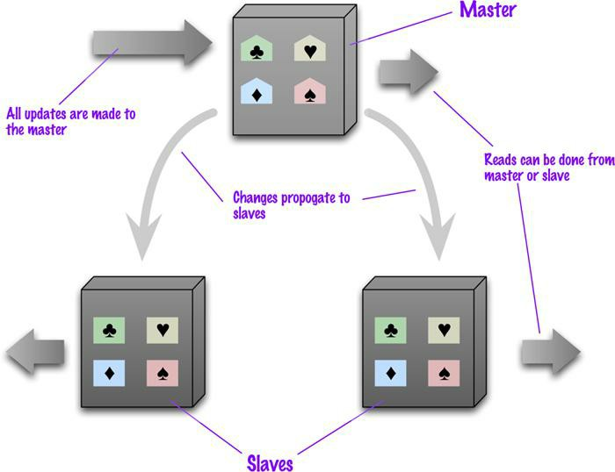
Master-Slave Replication
Master
is the authoritative source for the data
is responsible for processing any updates to that data
can be appointed manually or automatically
Slaves
A replication process synchronizes the slaves with the master
4
 After a failure of the master, a slave can be appointed as new master very quickly
CREDITS: Jimmy Lin (University of Maryland)

Slide 5
Pros and cons of Master-Slave Replication
Pros
More read requests:
Add more slave nodes
Ensure that all read requests are routed to the slaves
Should the master fail, the slaves can still handle read requests
Cons
The master is a bottleneck
Limited by its ability to process updates and to pass those updates on
Its failure does eliminate the ability to handle writes until:
the master is restored or
a new master is appointed
Inconsistency due to slow propagation of changes to the slaves
Bad for datasets with heavy write traffic

Slide 6
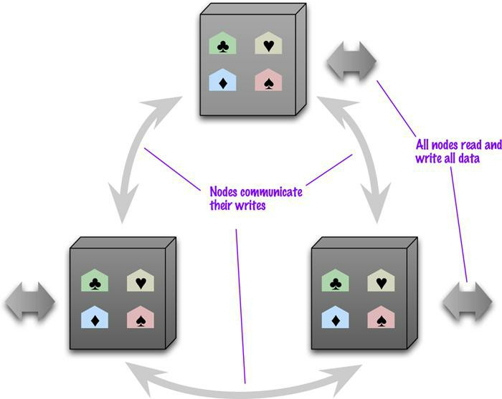
Peer-to-Peer Replication
All the replicas have equal weight, they can all accept writes
The loss of any of them doesn’t prevent access to the data store.

Slide 7
Pros and cons of peer-to-peer replication
Pros:
you can ride over node failures without losing access to data
you can easily add nodes to improve your performance
Cons:
Inconsistency!
Slow propagation of changes to copies on different nodes
Inconsistencies on read lead to problems but are relatively transient
Two people can update different copies of the same record stored on different nodes at the same time - a write-write conflict.
Inconsistent writes are forever.

Slide 8


Consistency
Biggest change from a centralized relational database to a cluster- oriented NoSQL
Relational databases: strong consistency
NoSQL systems: mostly eventual consistency

Slide 9
Conflicts
Read-read (or simply read) conflict:
Different people see different data at the same time
Stale data: out of date
Write-write conflict
Two people updating the same data item at the same time
If the server serialize them: one is applied and immediately overwritten by the other (lost update)
Read-write conflict:
A read in the middle of two logically-related writes

Slide 10
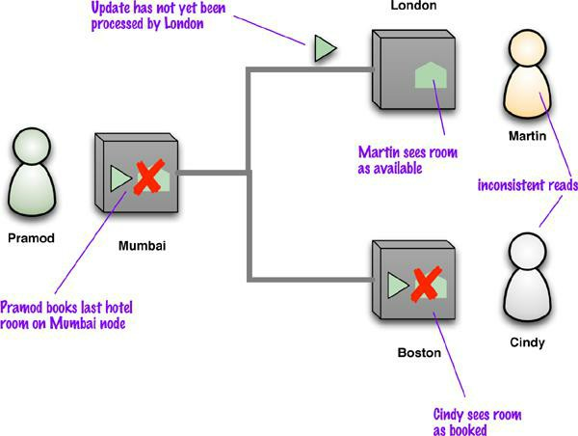
Read conflict
 Replication is a source of inconsistency

Slide 11
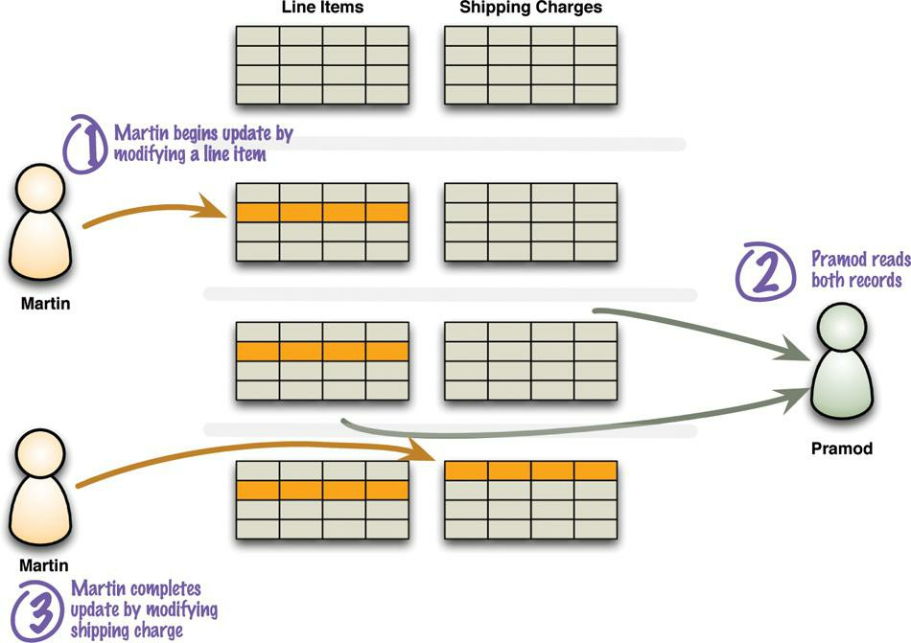
Read-write conflict
 A read in the middle of two logically-related writes

